Slide 1

ACCIDENT SEVERITY DATA ANALYSIS-CAPSTONE PROJECT
TUESY BHARADWAJ

Slide 2
Seattle-Accident Severity Data Analysis
Table of Contents
Introduction to the Business Problem
Data Preparation
Exploratory Data Analysis
Machine Learning Algorithms
Conclusion

Slide 3
Introduction
Car accidents are increasing everyday across the globe. As per WHO reports, approximately 1.35 million people die each year as a result of road traffic crashes
As per Seattle Traffic stats report, In 2015, a crash occurred in Washington state every 4.5 minutes and Seattle is the 8th most dangerous city for car accidents in the United States
In our data set, we are analysing accident severity of the car accidents that have taken place from 2004 onwards
We will also find out if some variables in the data set have affect on the accident severity or if we can predict Accident Severity the same using the same independent factors
This exercise can help hospitals, traffic department, police and other emergency staff to anticipate and be prepared for tough situations on road

Slide 4
Data Preparation
Data Source: This data have been collected and shared by the Seattle Police Department (Traffic Records)
Data Location: https://github.com/TuesyBharadwaj/Coursera_Capstone
Data set name: Data-Collisions.csv It has 37 attributes and a little more than 0.1 million rows with the accidents’ severity data. We will be looking into the below attributes to predict accident severity
The data describes two types of Severity for accidents
-> Injury collision
-> Property Damage by collision

Slide 5
We will be looking into the below attributes to predict accident severity
1. Road Condition (Wet, Dry, Sand, Oil, Mud, Snow,)
2. Weather Condition (Clear, Sun, Partly cloudy, rainy,)
3. Light Condition (Daylight, Dark, Dusk)
We will find out answers to the below questions
What are the factors that have a high impact on road accidents?
Is there a pattern to them?
Is there any Correlation?
Can we suggest some additional parameters for better
analysis
Light
Condition
Weather
Accident Severity
Road condition

Slide 6
Exploratory Data Analysis
Data Cleaning:
Converted the features like weather, road and light conditions which have string values into Numerical data
For Attention id, Underinfl and Speeding delete NaN values and Replace N with blanks
Redundant columns- There are no redundant columns or rows in the data set
Delete the below not related columns
X
Y
OBJECTID
INCKEY
COLDETKEY
INTKEYCROSSWALKKEY

Slide 7
Data preparation
Extract year and month from date column and create a new column for analysis in the data frame
df_data_1['year'] = pd.DatetimeIndex(df_data_1['INCDATE']).year
df_data_1.head()
df_data_1['month'] = pd.DatetimeIndex(df_data_1['INCDATE']).month
df_data_1.head()

Slide 8
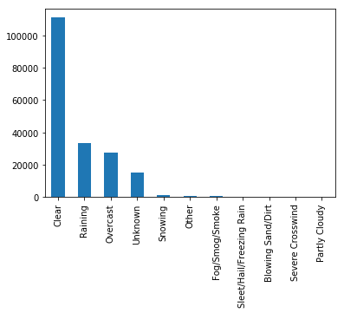
Exploratory Data Analysis
Analysis -1
ACCIDENT COUNT ANALYSIS
Analysis-2
WEATHER CONDITION ANALYSIS
SEVERITYDESC | Count
Property Damage Only Collision | 136485
Injury Collision | 58188
The number of incidents by above analysis show that Injury collision cases are 29.89% of total cases. In the rest 70.10%, only property was damaged
Above Figure shows that in 57% cases when accident took place the weather was Clear followed by raining, overcast, snow and unknown reasons

Slide 9
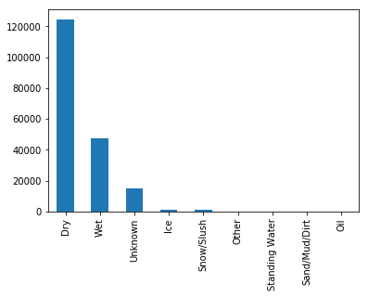
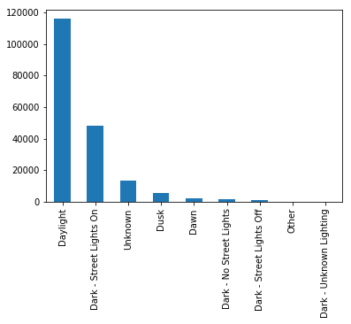
Analysis -3
Analysis -4
ROAD CONDITION ANALYSIS
LIGHT CONDITION ANALYSIS
Figure shows that in 70% accidents, the road condition was dry followed by wet, unknown ,ice and snow
Figure shows Close to 60% accident cases had light condition as broad daylight followed by dark street light on

Slide 10
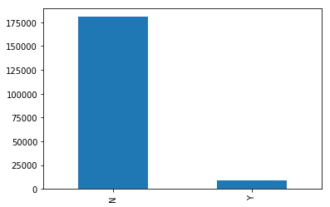
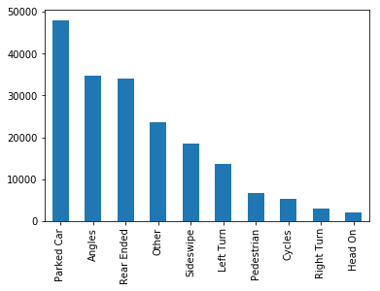
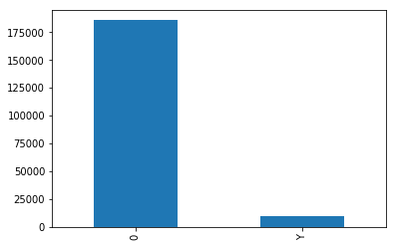
Analysis -5
Analysis -6
Analysis -7
UNDERINFLUENCE OF ALCOHOL
COLLISION TYPE ANALYSIS
SPEEDING
92% cases the driver was not under the influence of alcohol
Most collisions types were parked cars, angels, rear ended, sideswipe followed by left turn, pedestrian, cycle, right turn and head on
In most cases, the driver was not speeding

Slide 11
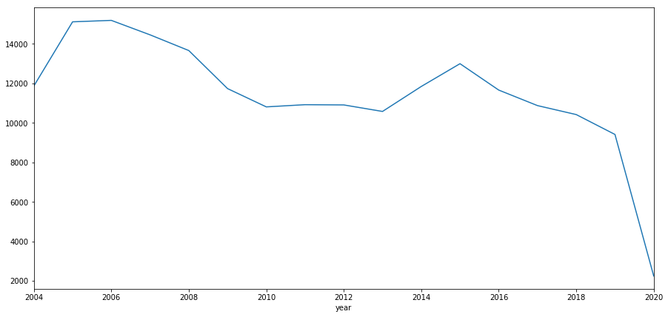
ACCIDENT CASES YEAR ON YEAR
Analysis -8
Figure shows the year on year cases of accidents that happened from 2004 onwards till May 2020 in Seattle. There is a downward trend in the number of accidents with a peak in 2014 and 2015

Slide 12
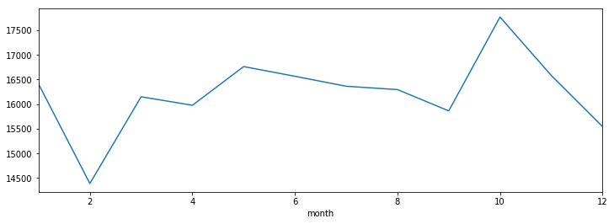
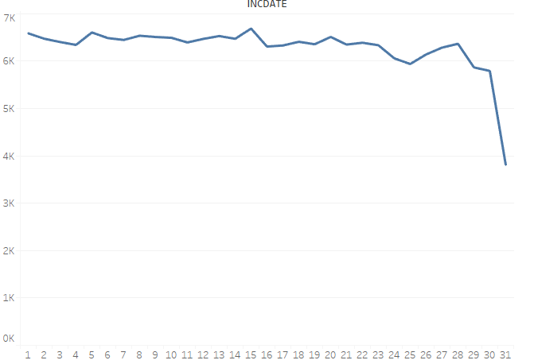
Analysis -9
Analysis -10
ACCIDENT CASES DAY ON DAY
ACCIDENT CASES MONTH ON MONTH
Figure explains that during certain months (i.e. January, March, May, June, July, August, October) the accident count increases
Number of Accidents remain approximately same throughout the month with a sharp decline on 31st of every month

Slide 13
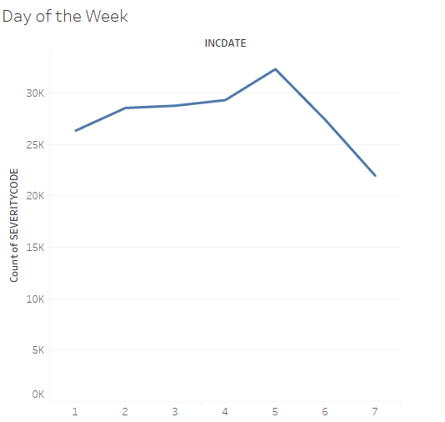
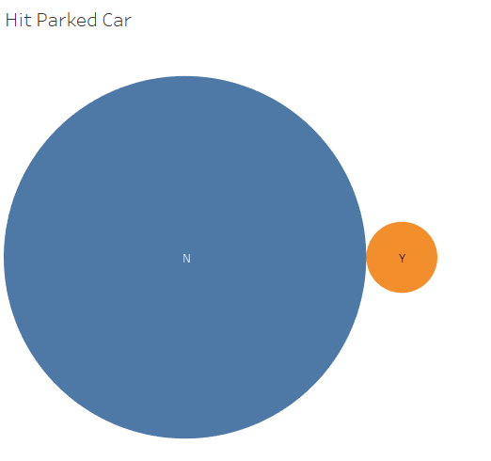
Analysis -11
Analysis -12
WEEKDAY WEEKEND ANALYSIS
HIT CAR PARKED ANALYSIS
Figure explains that accidents are on a rise on Friday and there is a drop of accidents on the Weekend (i.e. Saturday and Sunday)
Figure shows that in 96% accidents, parked car was not hit

Slide 14
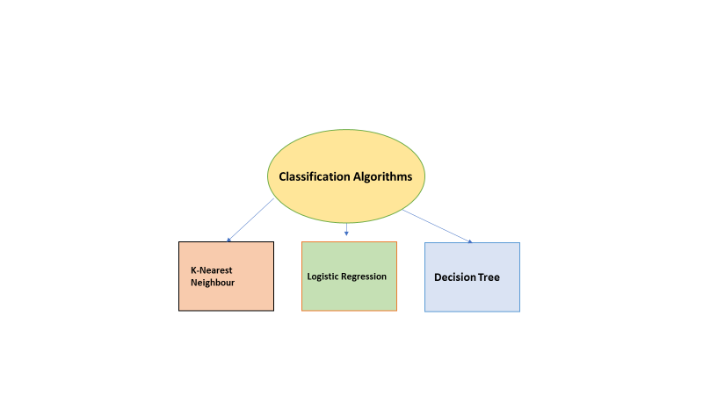
Machine Learning Algorithms
This is a scenario for a classic classification problem
It has 2 discrete targets that needs to be predicted
We will be using the standard classification machine learning algorithms. The predictors used are: ‘Weather’, ’Roadcond’, ’Lightcond’.
These predictors were categorical in nature hence we can apply the 3 machine learning models to predict the target

Slide 15
Classification -KNN
In KNN model we follow the below steps
Load data and normalize
Divide data set into Training and testing set
Predict using KNN algorithm and evaluate accuracy
Plot model accuracy
Calculate F1 score and Jaccard index
We try to find accuracy of the model by taking K=4 initially and check the accuracy. The accuracy is coming as below
Train set Accuracy | Test set Accuracy
0.5418138155106653 | 0.5452420701168614

Slide 16
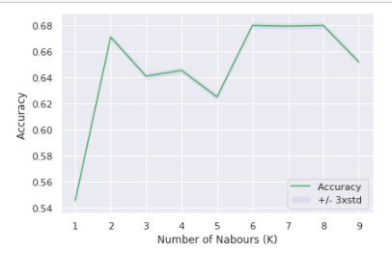
We then plot a graph to see for which K value the accuracy is the maximum
The best accuracy was with 0.6800308205984333 with k= 6

Slide 17
Logistic regression- Liblinear and SVM
Logistic Regression is used when the dependent variable is categorical in nature. Here there are 2 outputs
SEVERITYCODE 1- Property damage only collision
SEVERITYCODE 2- Injury collision
We created model in Jupyter notebook with solver as Lib linear first and below was the classification report
 | precision | recall | F1-Score | support
1 | 0.70 | 1.0 | 0.83 | 27425
2 | 0.0 | 0.0 | 0.0 | 11510
Micro Avg | 0.70 | 0.70 | 0.70 | 38935
Macro Avg | 0.35 | 0.50 | 0.41 | 38935
Weighted Avg | 0.50. | 0.70 | 0.58 | 38935
Algorithm is not able to predict the class 2 target correctly. This is because the data is severely Imbalanced with more cases for Type 1 Severity i.e Property damage

Slide 18
Downsampling dataset
As the data set is severely imbalanced we need to down sample the data set
For doing the same, we create two data fame for Majority class and Minority class
# Separate majority and minority classes
df_majority = df_pandas[df_pandas.SEVERITYCODE==1]
df_minority = df_pandas[df_pandas.SEVERITYCODE==2]
The sample size is now as below
We perform Logistic regression on the data set again
2 58188
1 58188 Name: SEVERITYCODE, dtype: int64

Slide 19
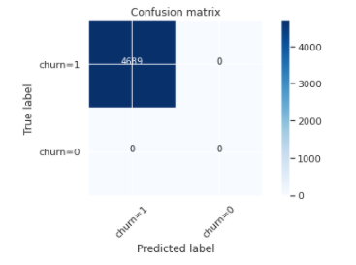
After doing down sampling we get the below accuracy
We observe that the accuracy has improves slightly but its still not upto the mark.
Confusion Matrix
We can conclude that this model is not adequate for predicting correct outcome for our business problem
We can see from the Confusion Matrix that the model predicts True Positives correctly and not the rest ( TN, FP, FN).

Slide 20
Decision Tree Model
Since, the data set is imbalanced, we can use Decision tree model for prediction
Decision trees often perform well on imbalanced datasets because their hierarchical structure allows them to learn signals from both classes
We built the model in Jupyter notebook using depth as 4
Decision Trees's Accuracy: 0.6994109790760591
Clear
Weather
Rain
Severity
Overcast

Slide 21
Conclusion
We have used the independent variables of Weather, Road and Light Conditions to build the model.
The accuracy for KNN model is 0.68 and for Decision tree is 0.699
The Accuracy for Logistic regression is 0.54 which is lesser than the remaining two models
By the analysis, we can interpret that the accident severity can depend on the variables we have taken into consideration and KNN model & Decision tree will be ideal models to predict the Accident Severity
In future, we can suggest the traffic department at Seattle to capture some other parameters in this data set for generating better insights
We can include Age of the driver and Accident zones
This will help to analyse whether the accidents are occurring in a particular age group, and also if there are a specific zone where more accidents take place.
The traffic department can be prepared for possible accidents in some areas and the hospital staff along with ER team can be at alert for better management of situation

Slide 22
Thanks for reading!
End of Presentation

